Slide 1
STARGAN-VC: NON-PARALLEL MANY-TO-MANY VOICE CONVERSION WITH STAR GENERATIVE ADVERSARIAL NETWORKS
Authors :
Hirokazu Kameoka (Senior Distinguished Researcher at NTT, Adjunct Associate Professor at NII)
Takuhiro Kaneko( Distinguish researcher at NTT Communication Science Laboratories in NTT Corporation )
Kou Tanaka ( Research scientist at NTT )
Nobukatsu Hojo (Research scientist at NTT )
Group Details:
Rajat Kumar (1806040)
Pampana Bharath Kumar (1806044)
Gunturu Siddharth (1806131)

Slide 2
Voice Conversion Challenge (VCC) 2018 Dataset
The dataset consists of recordings of six female and six male US English speakers.
We used a subset of speakers for training and evaluation.
Specifically, we selected two female speakers ‘VCC2SF1’ and ‘VCC2SF2’. Two male speakers, ‘VCC2TM1’ and ‘VCC2TM2’.
But in paper they used ‘VCC2SF1’, ‘VCC2SF2’, ‘VCC2SM1’ and ‘VCC2SM2’.
There is nothing difference in that.

Slide 3
Pre-processing of data
Before going to train the model it is required to pre-process the data.
It is required to convert the audio samples into some featured vectors.
For each utterance, a spectral envelope, a logarithmic fundamental frequency (log F0), and aperiodicities (APs) were extracted every 5 ms using the WORLD analyzer.
A 36 Mel-cepstral coefficients (MCCs) were then extracted from each spectral envelope.
Extracted features (mcep, f0, ap) from each speech clip are stored as npy files.
We also calculate the statistical characteristics for each speaker.
The extracted npy files contains an array with acoustic features theses arrays are used to train the model.

Slide 4
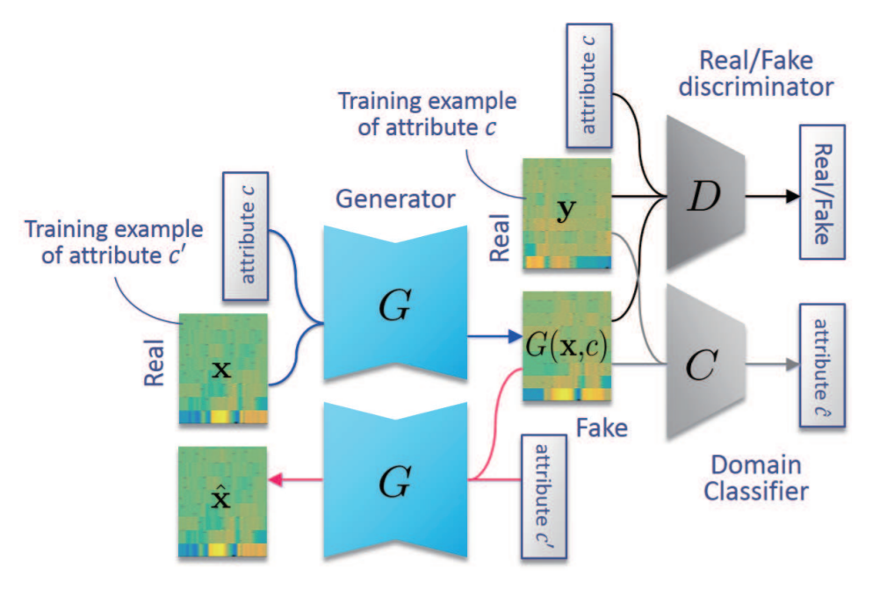
Training model StarGAN-VC
G be a generator that takes an acoustic feature sequence x ∈ R Q×N with an arbitrary attribute and a target attribute label c as the inputs and generates an acoustic feature sequence yˆ = G(x, c).
One of the goals of StarGAN-VC is to make
yˆ = G(x, c) as realistic as real speech attribute of c.
The Domain classifier C, whose role is to predict to which classes an input belongs.
Discriminator D is designed to produce a probability D(y, c) that an input y is a real speech feature whereas C is designed to produce class probabilities Pc (c|y) of y.

Slide 5
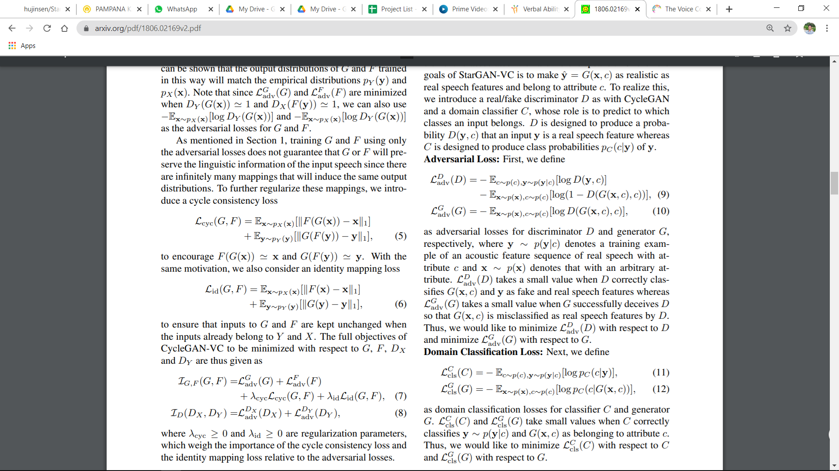
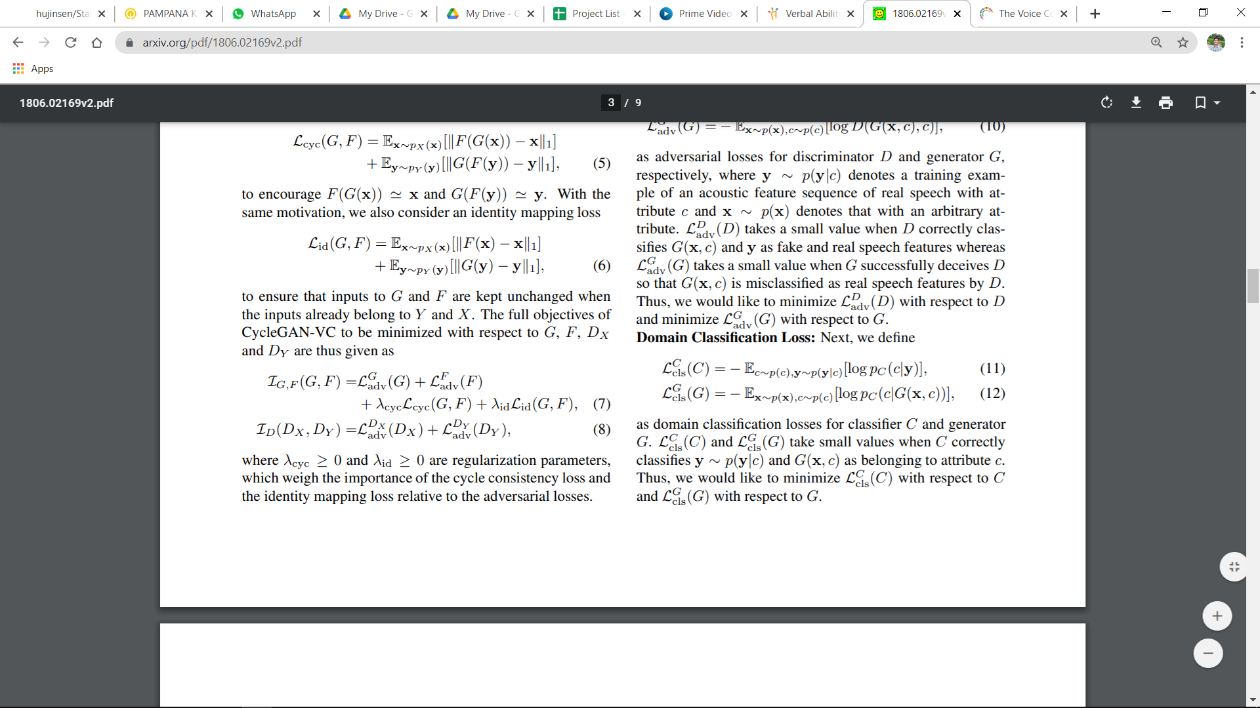
Adversarial losses for discriminator D and generator G
where y ∼ p(y|c) denotes a training example of an acoustic feature sequence of real speech with attribute c and x ∼ p(x) denotes that with an arbitrary attribute
we would like to minimize Ladv(D) with respect to D and minimize Ladv(G) with respect to G.
Domain classification loss
we would like to minimize Lcls (C) with respect to C and Lcls (G) with respect to G

Slide 6
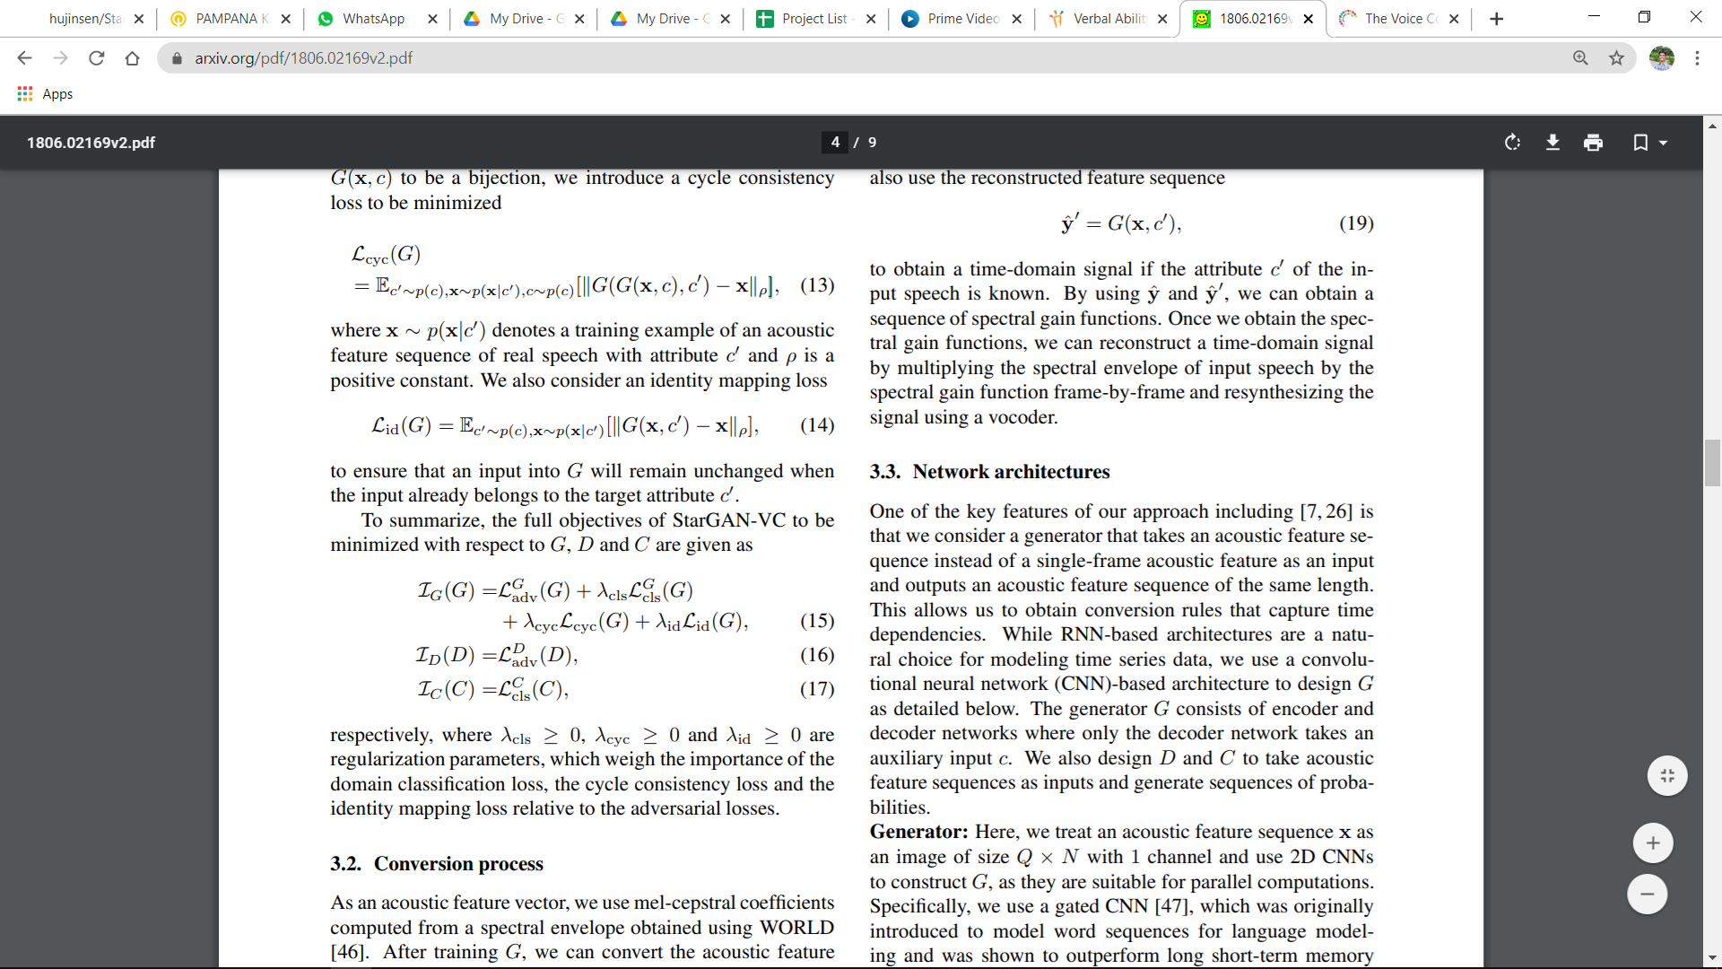
Cycle Consistency Loss
(where x ∼ p(x|c ′ ) denotes a training example of an acoustic feature sequence of real speech with attribute c ′ and ρ is a positive constant.)
The full objectives of StarGAN-VC to be minimized with respect to G, D and C are
(where λcls ≥ 0, λcyc ≥ 0 and λid ≥ 0 are regularization parameters.)

Slide 7
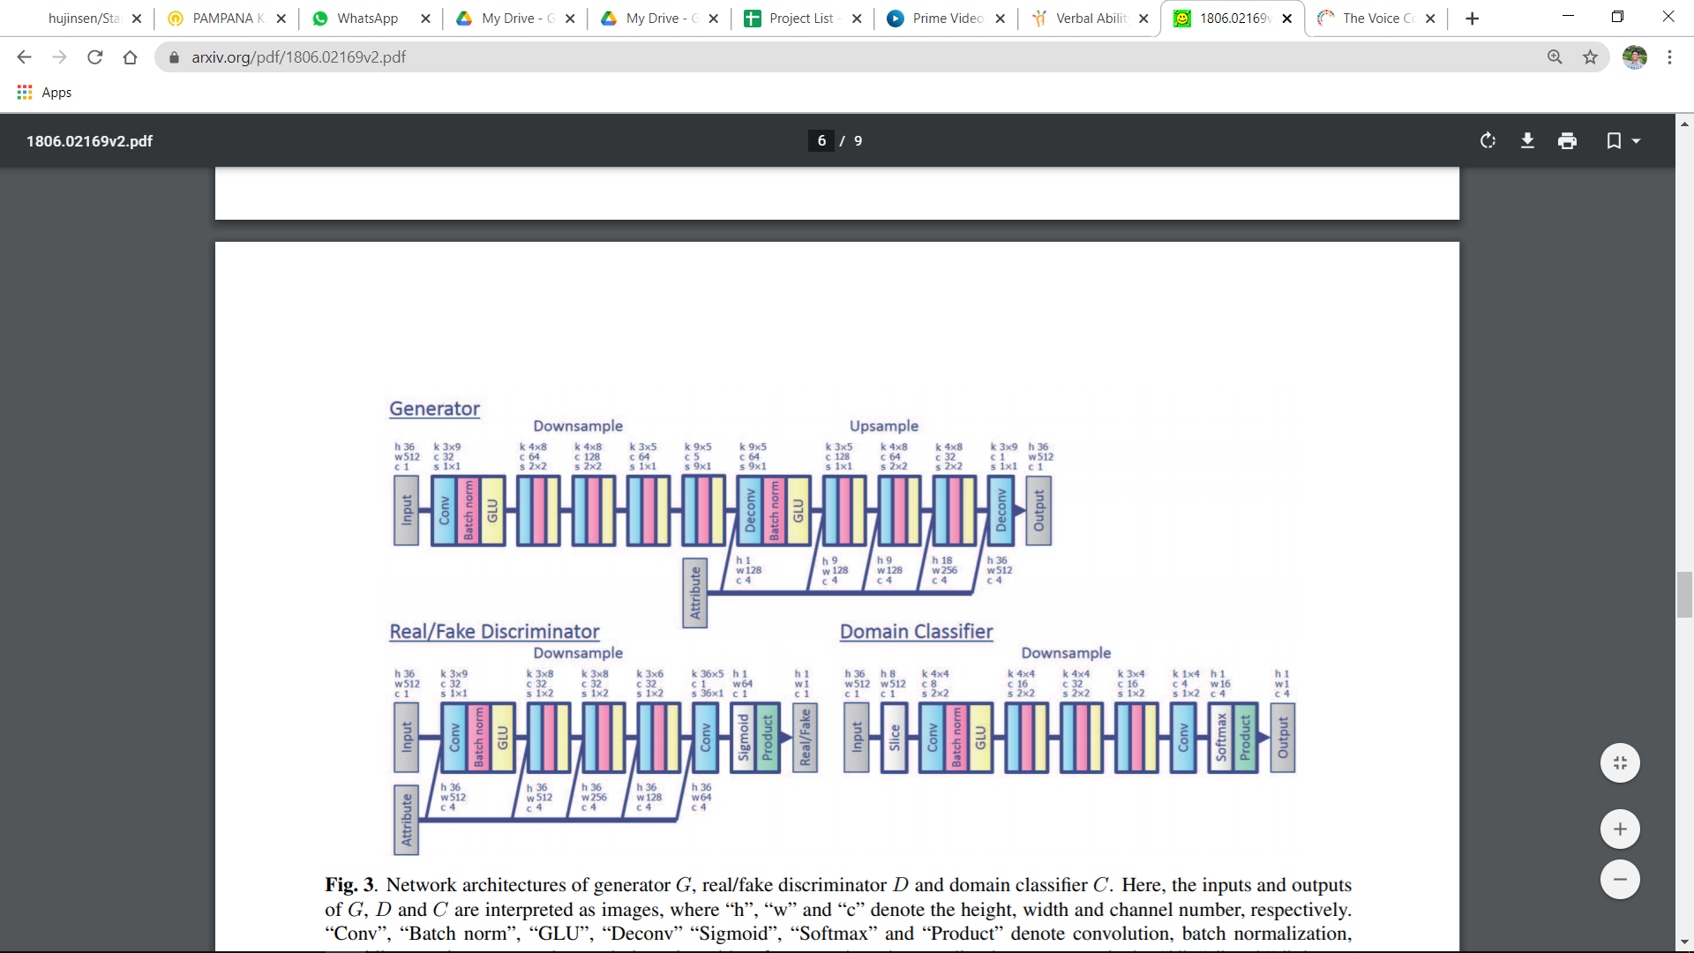
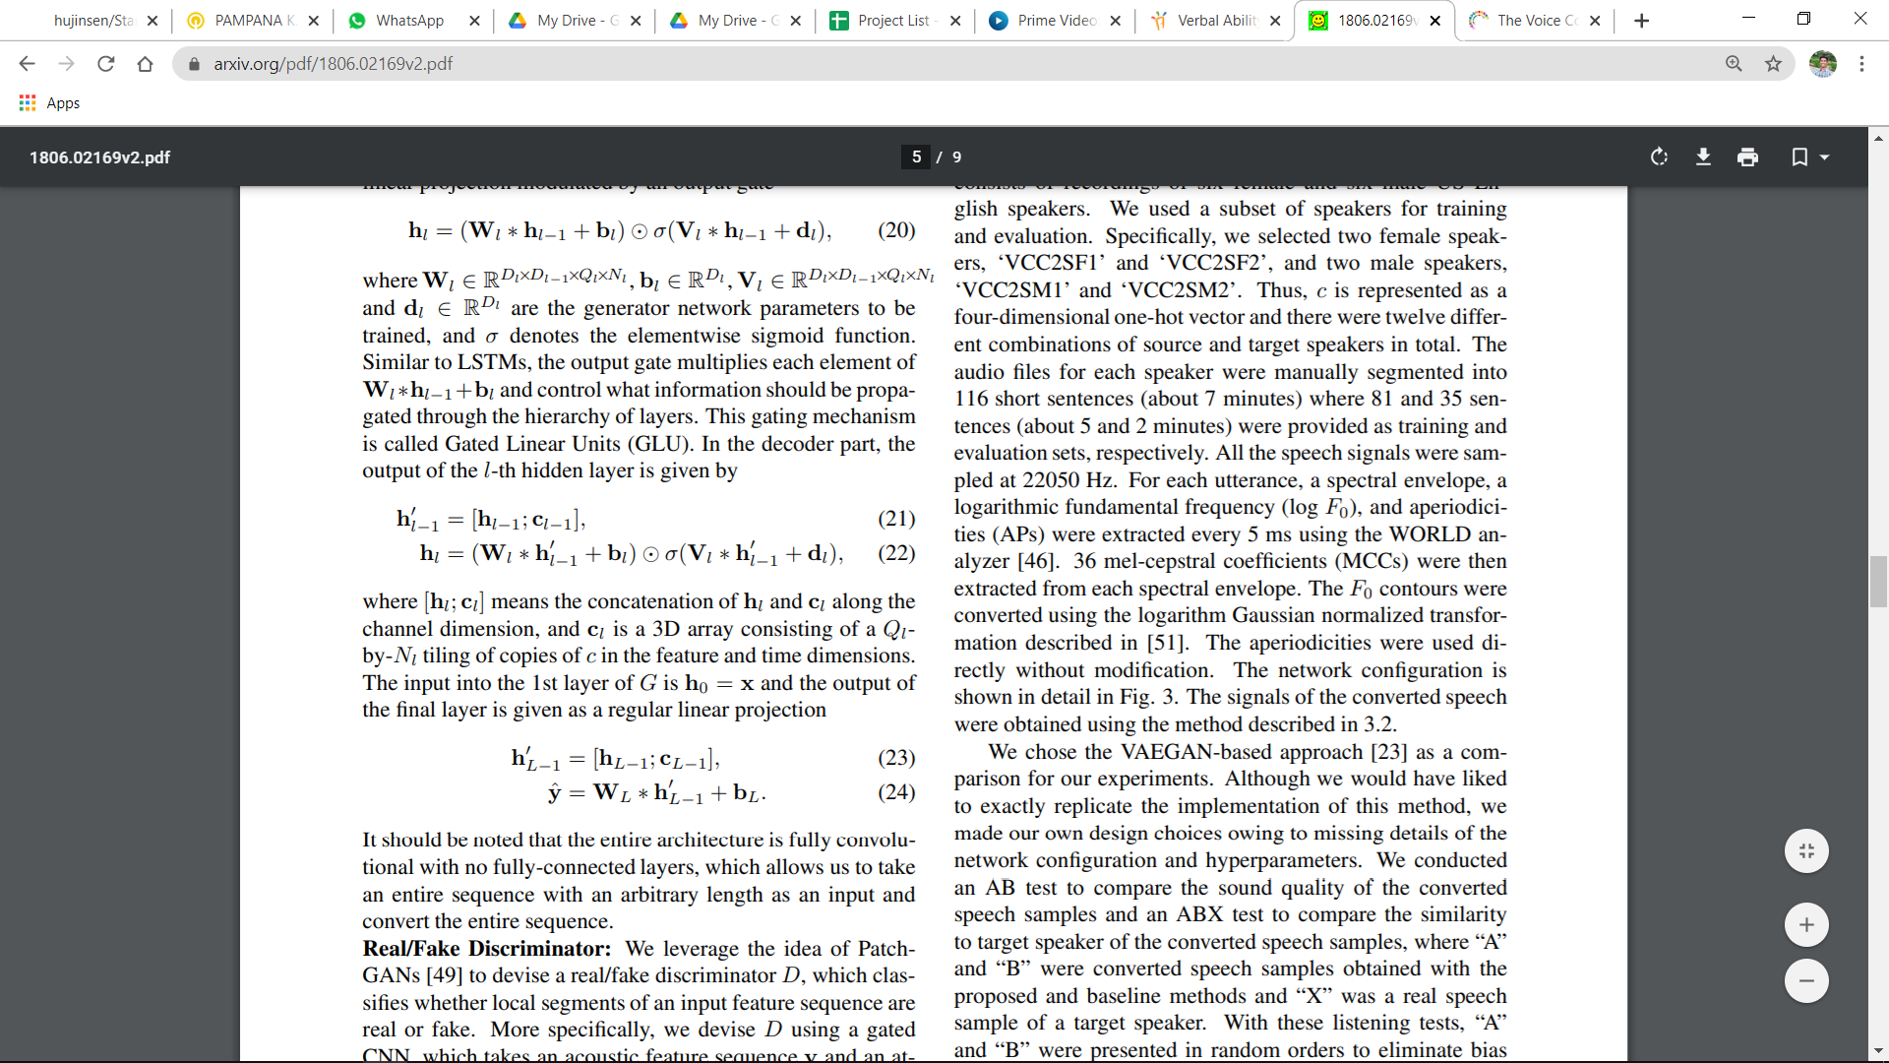

Convolutional Neural Networks
we treat an acoustic feature sequence x of size Q × N with 1 channel and use 2D CNNs to construct G
The output of the L-th hidden layer is described as a linear projection modulated by an output gate for encoder.
In the decoder part, the output of the L-th hidden layer is given by

Slide 8

Results given in paper
Results we got
SM1 (Male) → SF1 (Female)
TM1 (Male) → SF1 (Female)
SF1 (Female) → SM1 (Male)
SF1 (Female) → TM1 (Male)
As compare to the results given in paper our results are little bit noisy and some word are not clear.

